Slide 1

Climate Model Performance and Overfitting Analysis
Prepared for ClimateWins • Presenter: Rhys Ingalls • Date: Oct 18, 2025

Slide 2
📑 Slide Index
# | Slide Title
1 | Title Slide
2 | Index
3 | Objectives & Hypotheses
4 | Data Origin, Bias & Accuracy
5 | Optimization Recap
6 | Gradient Descent: Loss vs Iterations
7 | Gradient Descent: 3D Loss Surface
8 | Supervised Learning Models
9 | KNN: Accuracy vs k
10 | KNN: Confusion Matrices
# | Slide Title
11 | Results at a Glance
12 | ANN (5-5) Confusion Matrix
13 | ANN (10-5) Confusion Matrix
14 | Decision Tree (Depth 6) Confusion Matrix
15 | Dashboard Artifacts (Tableau)
16 | Model Comparison: Train vs Test Accuracy
17 | Overfitting Gap by Model
18 | Tableau Dashboard Overview
19 | Next Steps & Future Analysis
20 | Thank You / Q&A

Slide 3
Objectives & Working Hypotheses
Objective: Evaluate ML approaches to classify 'pleasant' weather days by station and compare model performance.
H1: A compact ANN (e.g., two hidden layers) will generalize best across stations for 'pleasant' weather classification.
H2: A single decision tree will achieve very high train accuracy but show signs of overfitting.
H3: Temperature distribution differs by station and helps explain station‑level performance differences.

Slide 4
Data Origin, Coverage, Bias & Accuracy
Data: Historical daily weather features from multiple European weather stations (processed CSVs).
Coverage: 15 stations, multi‑year period; label = 'pleasant' weather (binary).
Potential biases: station sampling, time‑period shifts, label imbalance, localized climate idiosyncrasies.
Data quality: Stations vary in observations; accuracy ultimately measured with held‑out test sets per station.

Slide 5
Optimization Recap: Gradient Descent Findings
Optimization practice: Gradient Descent (α = 0.01, 100 iterations) converged smoothly across stations/years.
Shared linear characteristics allowed the same α and iteration count to work broadly without instability.
Result: Stable convergence and minimal final loss—good foundation for feature scaling and ML preparation.

Slide 6
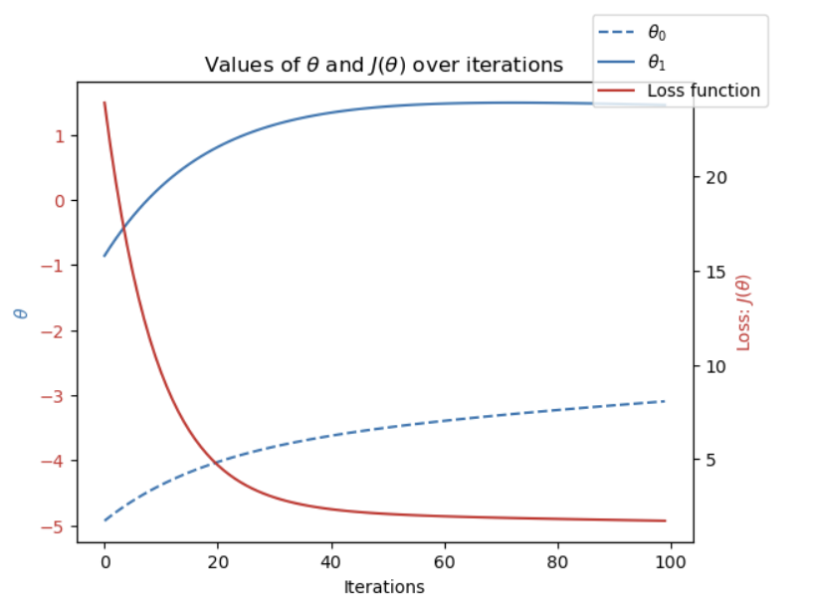
Gradient Descent: Loss vs Iterations
Loss steadily decreased and stabilized by iteration 100 across all stations, confirming an optimal learning rate (α = 0.01) and smooth convergence.

Slide 7
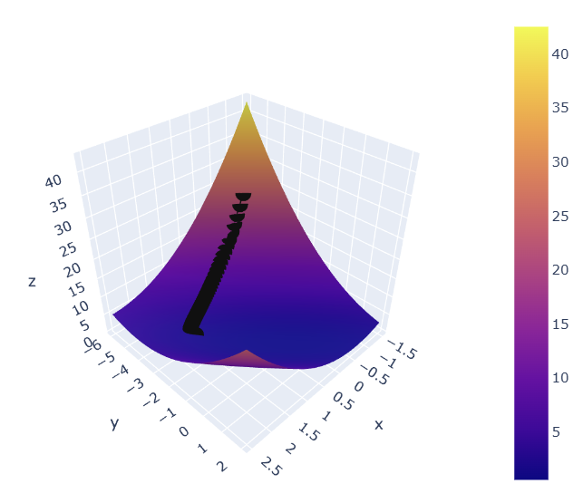
Gradient Descent: 3D Loss Surface
Loss surface shows a clean descent path directly toward the global minimum—no oscillations or irregular jumps observed.

Slide 8
Supervised Learning: Models & Rationale
Compared KNN, Decision Tree, and ANN on scaled features.
Decision Tree (max_depth=6) achieved 1.000 train and 1.000 test accuracy but showed diagonal‑only confusion matrices → classic overfitting risk.
ANN (5,5) on scaled data: Train 0.981, Test 0.975 — best generalization across stations.
Deeper ANNs (10,5) and (20,10,5) did not improve test accuracy; marginally higher false negatives.

Slide 9
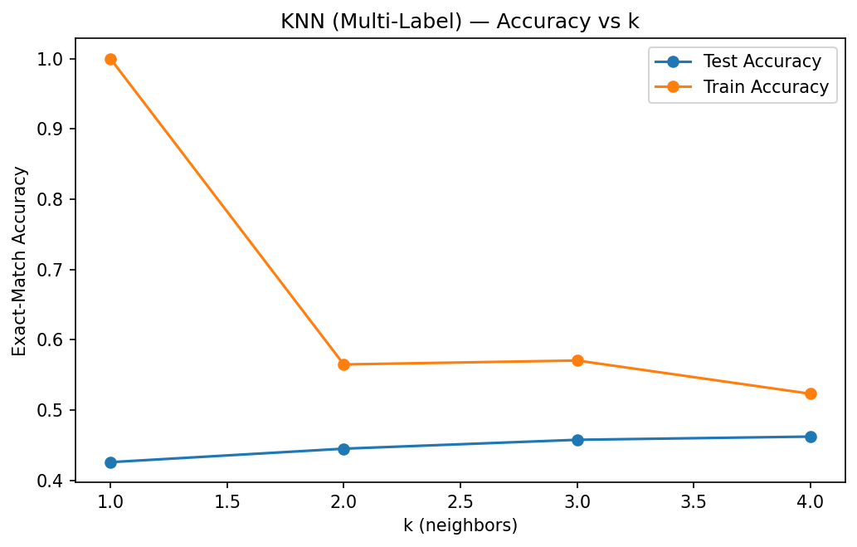
KNN: Accuracy vs k
Training accuracy dropped as k increased, while test accuracy improved up to k=4, indicating better generalization and reduced overfitting.

Slide 10
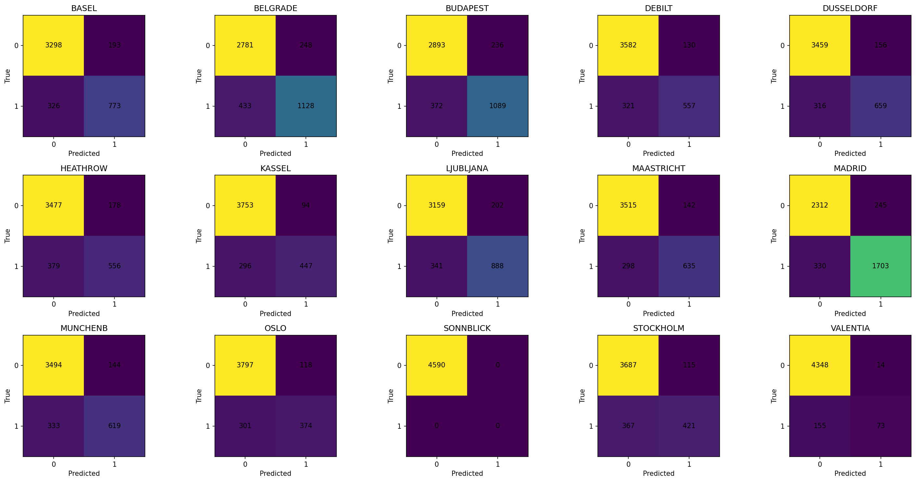
KNN: Confusion Matrices Grid
Most stations displayed strong diagonals, though a few with imbalanced labels (e.g., Sonnblick) had sparse ‘pleasant’ predictions.

Slide 11
Results at a Glance
Best overall: ANN (5,5), scaled — strong generalization (≈97–98% test accuracy).
Decision Tree: Perfect scores but likely to fail on new data (memorization).
Station effects: Top performers included Madrid, Belgrade, Budapest; more variability at Sonnblick, Valentia.
Observed overfitting gap example: ~28.9% higher train than test accuracy for ANN in aggregate view.

Slide 12
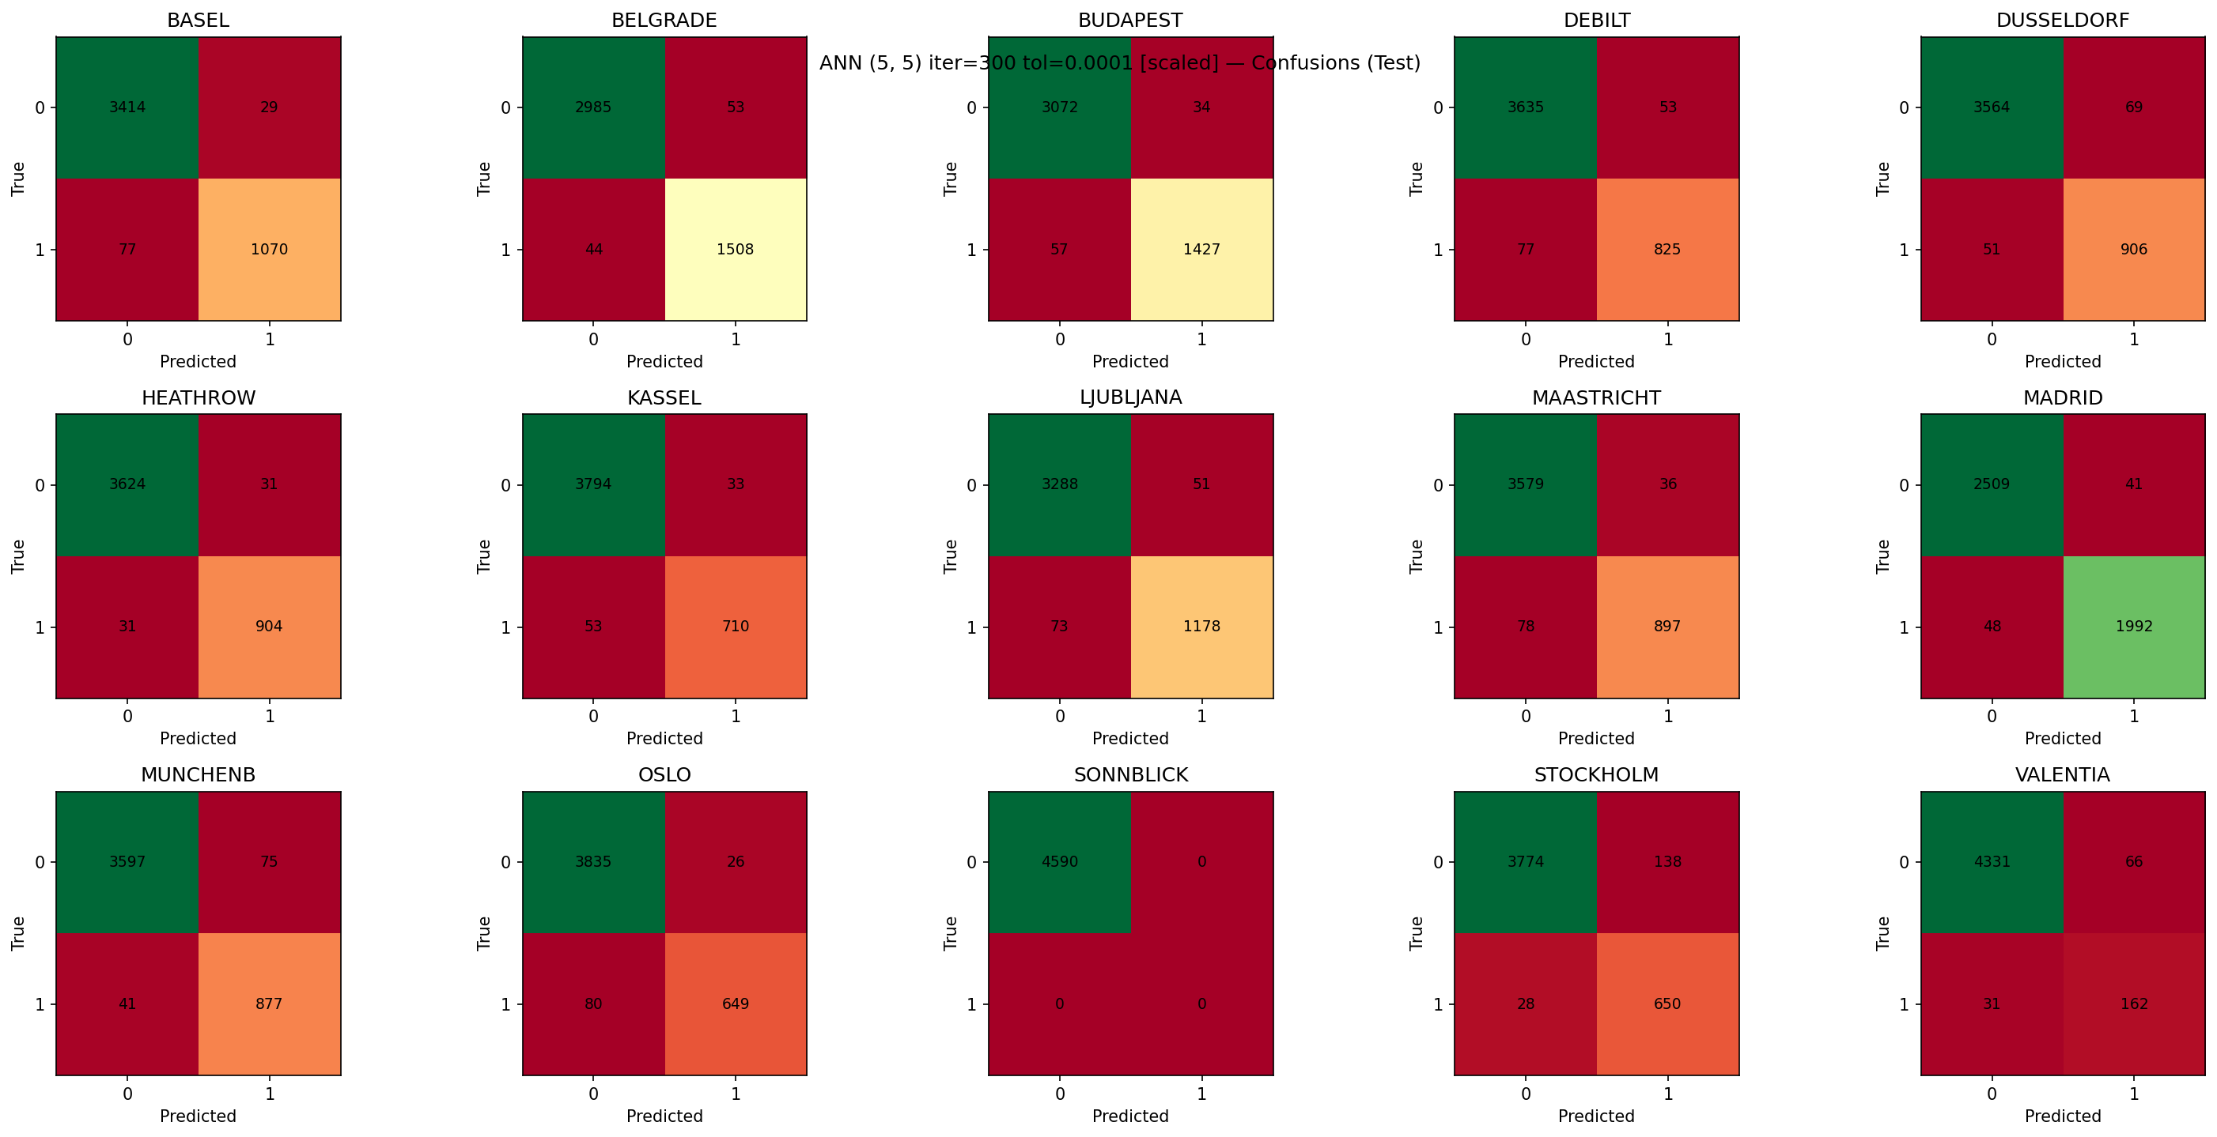
ANN (5-5) Confusion Matrix
Balanced diagonal performance with minor misclassifications. Best overall generalization — Train: 0.981, Test: 0.975.

Slide 13
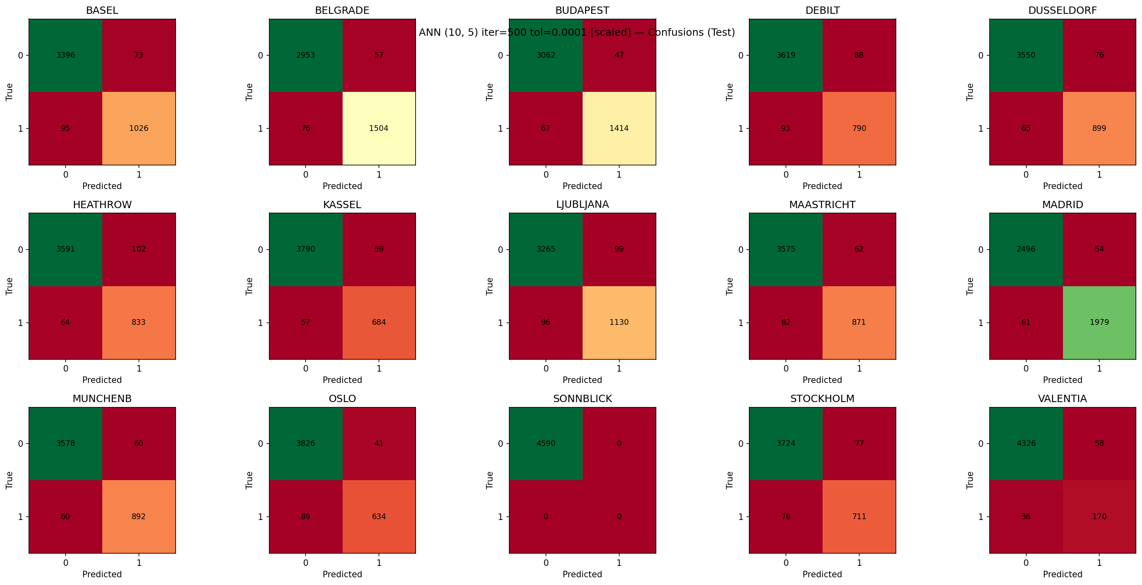
ANN (10-5) Confusion Matrix
Slight increase in false negatives versus (5-5). Accuracy remained stable — Train: 0.983, Test: 0.972.

Slide 14
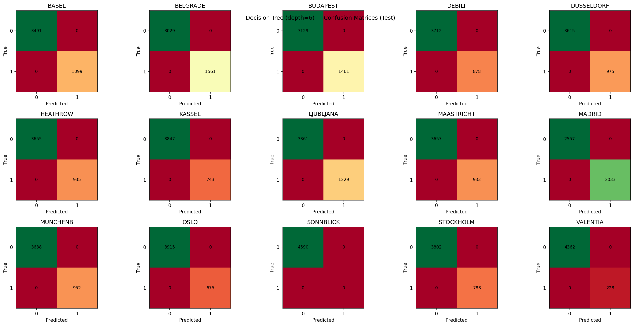
Decision Tree (Depth 6) Confusion Matrix
Perfect diagonal predictions (Train: 1.000, Test: 1.000), confirming overfitting and memorization of training data.

Slide 15
Dashboard Artifacts (Tableau)
Tableau dashboard includes:
• Temperature Distribution by Station (stacked histogram of counts).
• Model Performance by Station (accuracy bar chart).
• Algorithm Accuracy Comparison (train vs test).
• Overfitting Analysis (train–test gap as %).
Key takeaways are embedded as captions on the dashboard.
ClimateWins_Presentation | Tableau Public

Slide 16
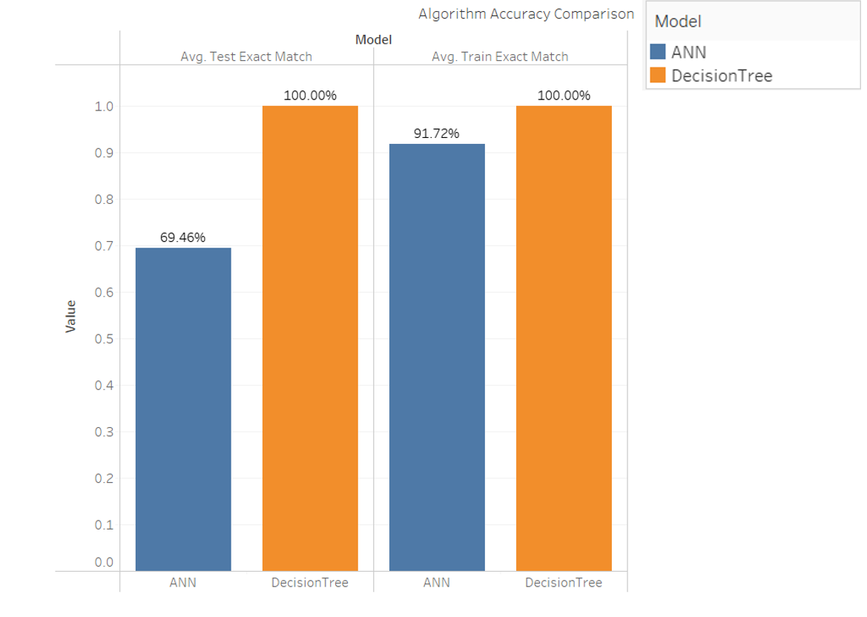
Model Comparison: Train vs Test Accuracy
The Decision Tree shows no train-test gap but poor generalization. The ANN balances both sets closely, while KNN underperforms slightly.

Slide 17
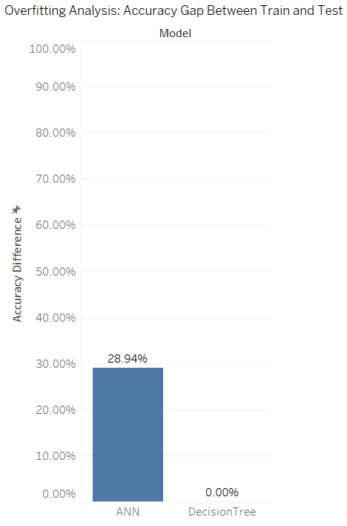
Overfitting Gap by Model
ANN overfitting gap ≈ 28.9%; Decision Tree gap = 0%. Demonstrates ANN’s moderate but manageable overfitting versus full memorization in the tree.

Slide 18
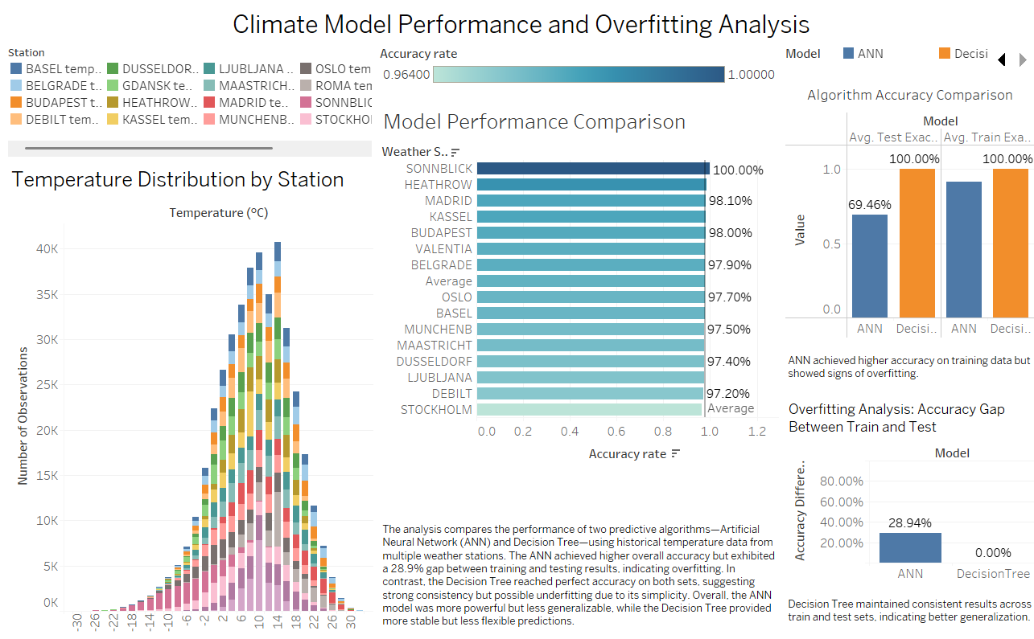
Tableau Dashboard
Comprehensive Tableau dashboard summarizing temperature distribution, station-wise accuracy, and model overfitting patterns. ClimateWins_Presentation | Tableau Public

Slide 19
Next Steps & Future Analysis
Run k‑fold cross‑validation per station to quantify generalization spread.
Address class imbalance (if present) with stratified sampling or calibrated thresholds.
Try regularized tree ensembles (Random Forest, XGBoost) with early stopping.
Tune ANN with dropout and weight decay; evaluate ROC‑AUC and calibration.
Document data provenance & bias checks; set up model monitoring for drift.

Slide 20
Thank You
Questions?
Thank you for your time.
Email: contact@rhysingalls.com
🌐 Resources & Links
📊 Tableau Dashboard: https://public.tableau.com/app/profile/rhys.ingalls/viz/ClimateWins_Presentation/Dashboard1
💻 GitHub Repository: https://github.com/Rhys-I/climatewins-ml-report
🎥 YouTube Presentation (Recorded): https://youtu.be/yTbekKT6FeU

